Slide 1

ES6 module
Unit 15

Slide 2
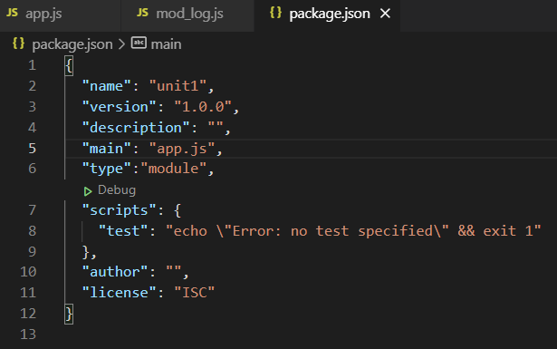
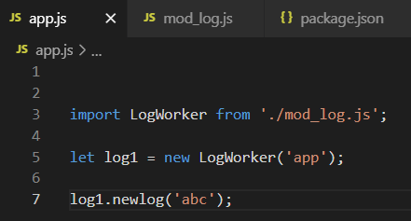
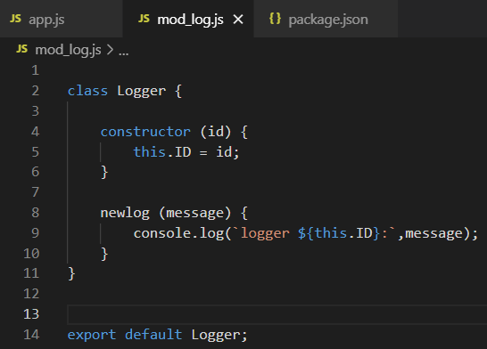
ES6 modules
Npm init to create Package.json. Then need add “type”:”module”
The .js file which has function of definition name need export to be used by others, use export statement
Other .js file which need to use, use import statement

